Slide 1
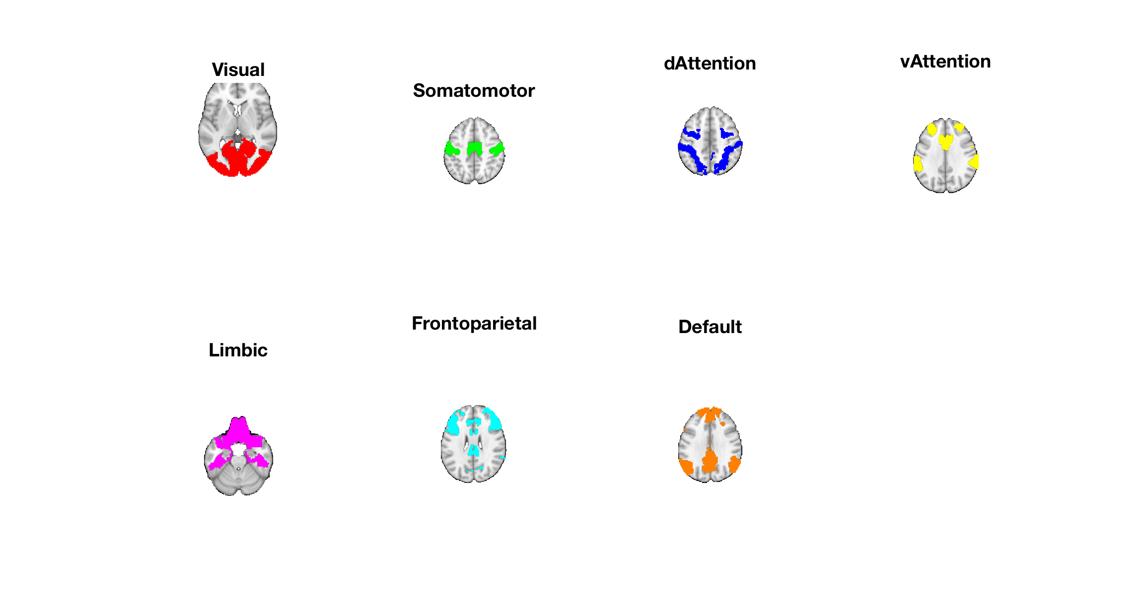
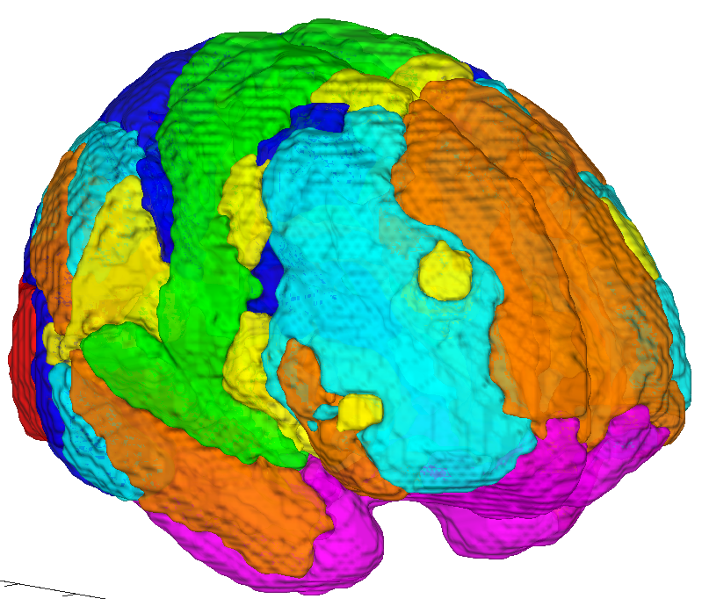
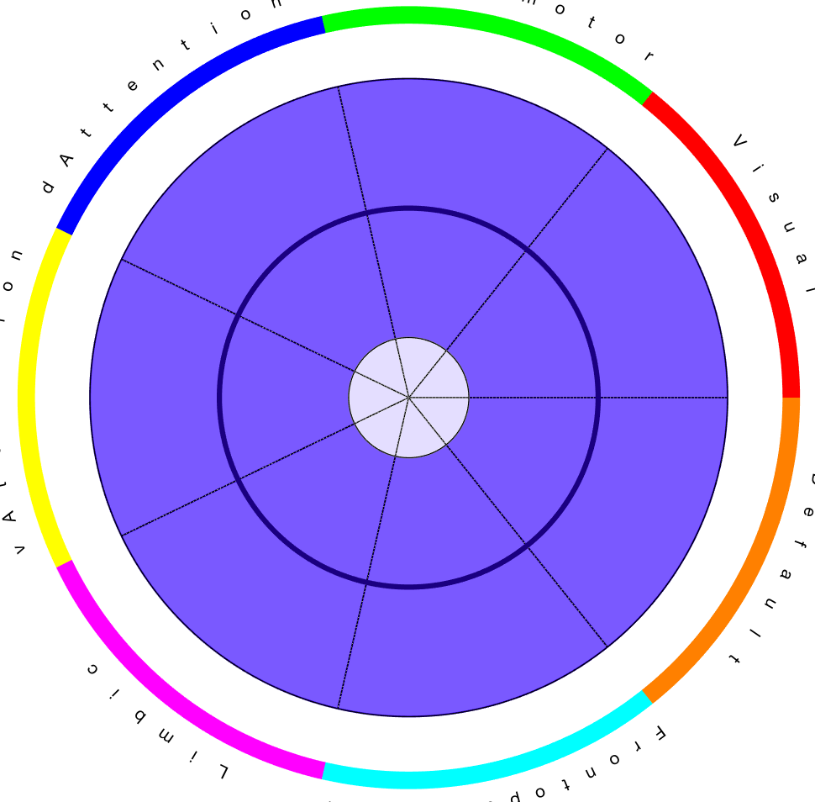
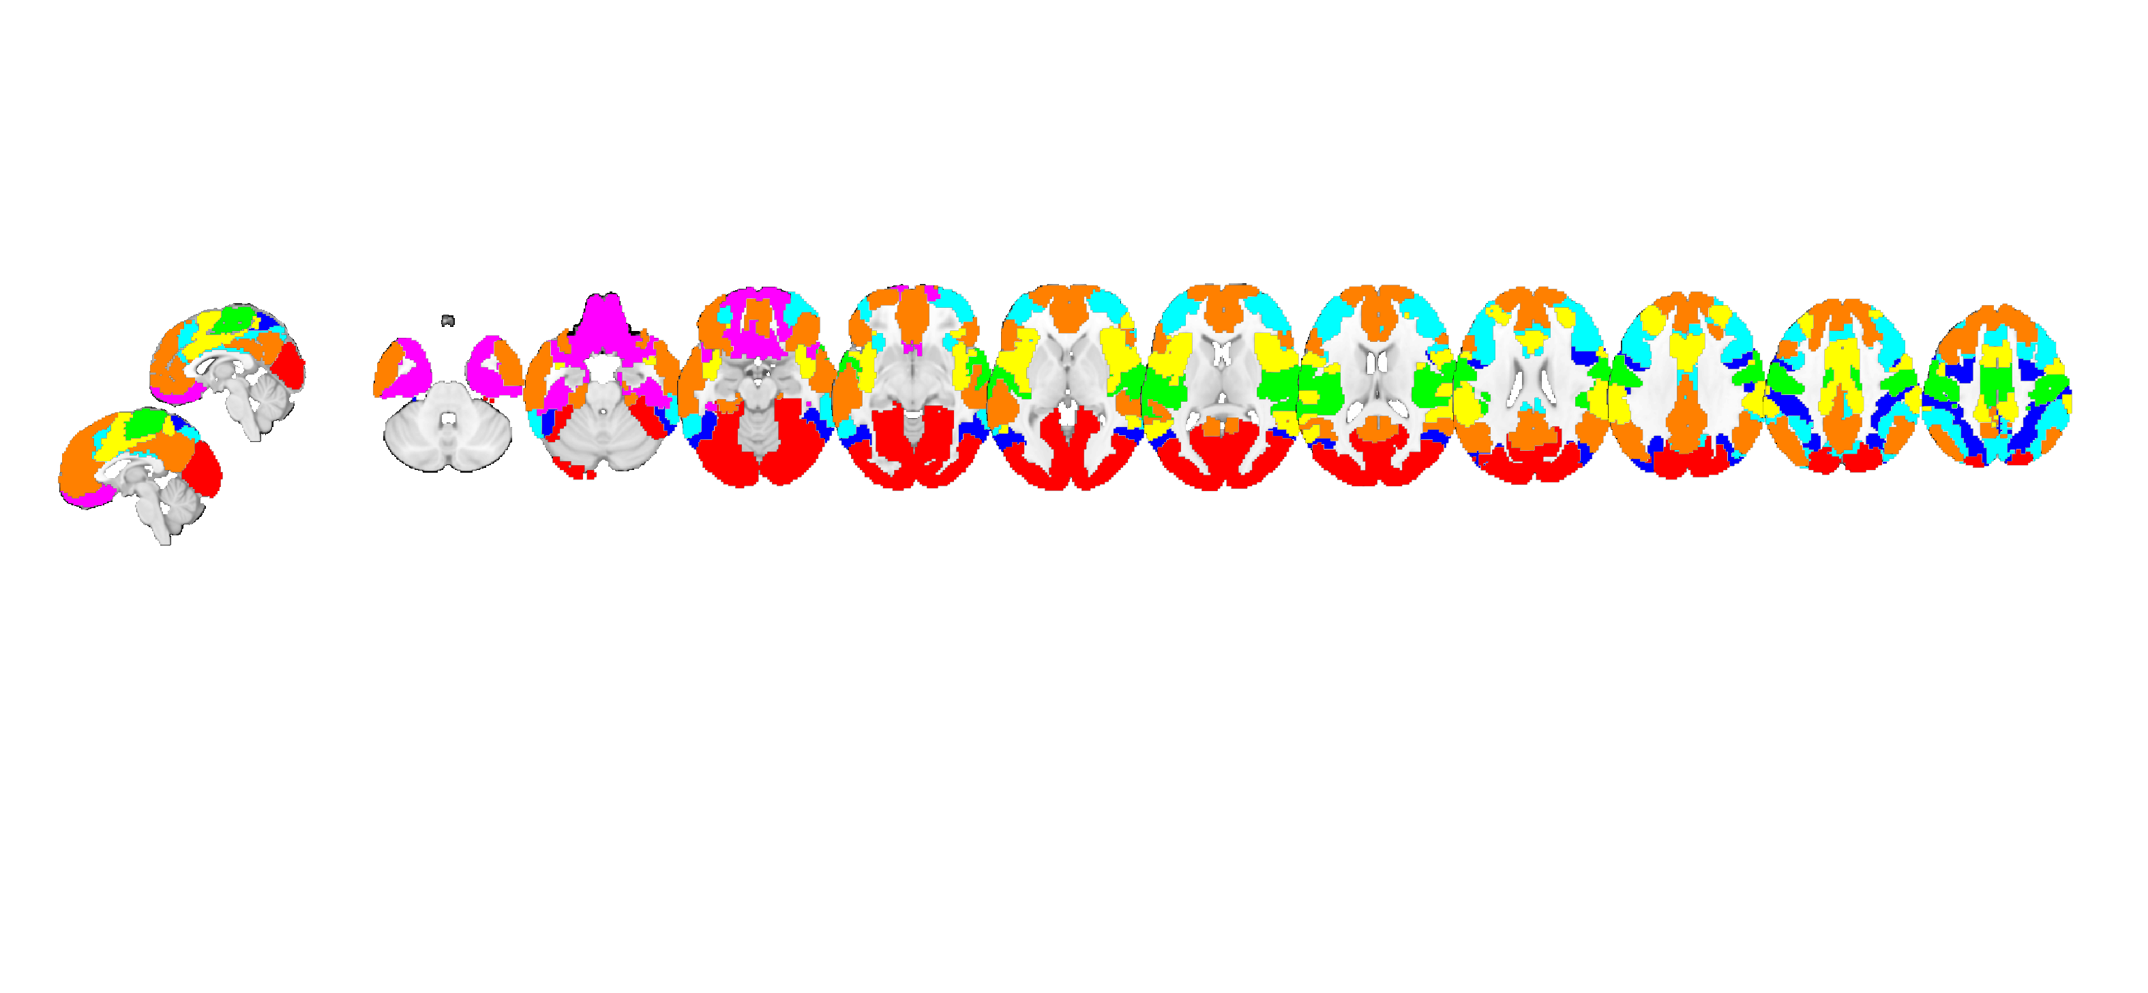
dAttn
SomMot
SomMot
dAttn
Vis
Vis
vAttn
vAttn
Cortical Networks
DMN
DMN
Limbic
Limbic
FPN
FPN

Slide 2
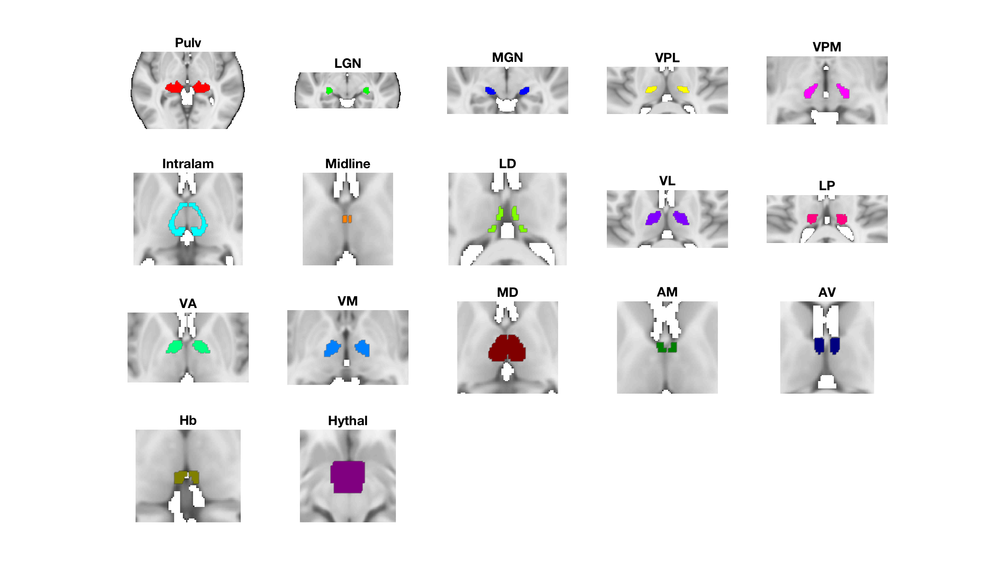
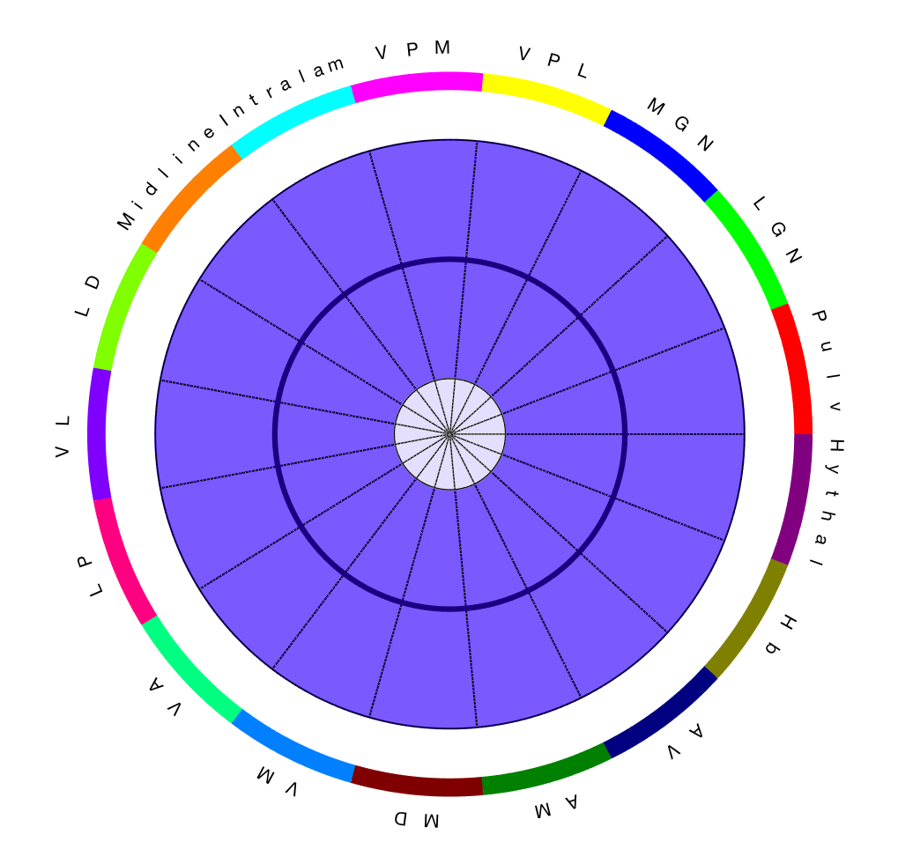
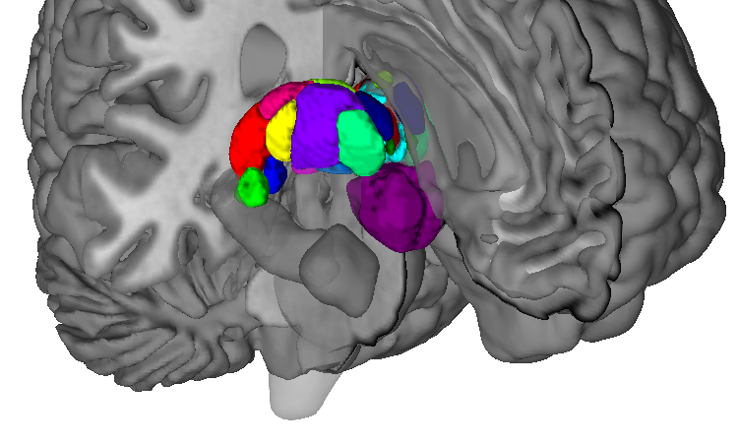
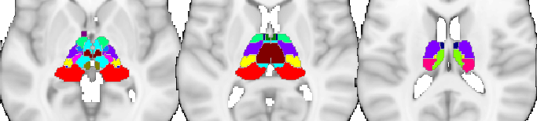
Thalamic regions

Slide 3
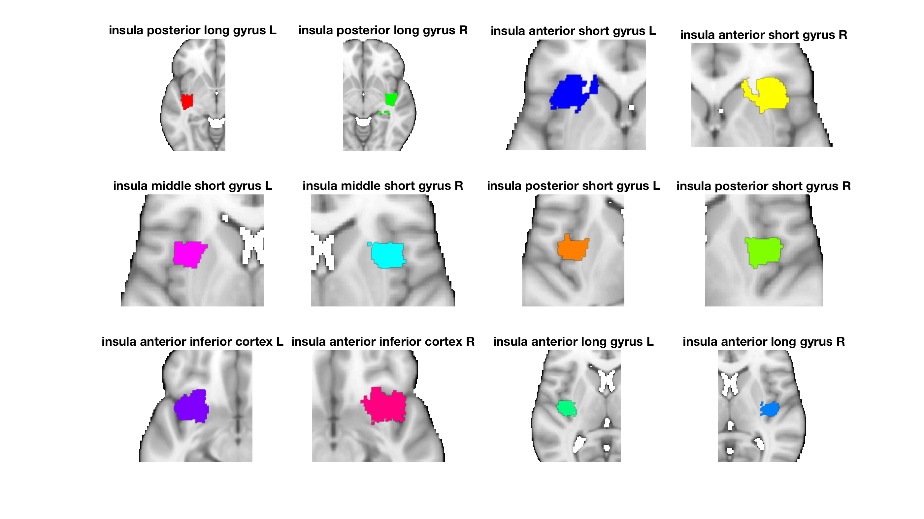
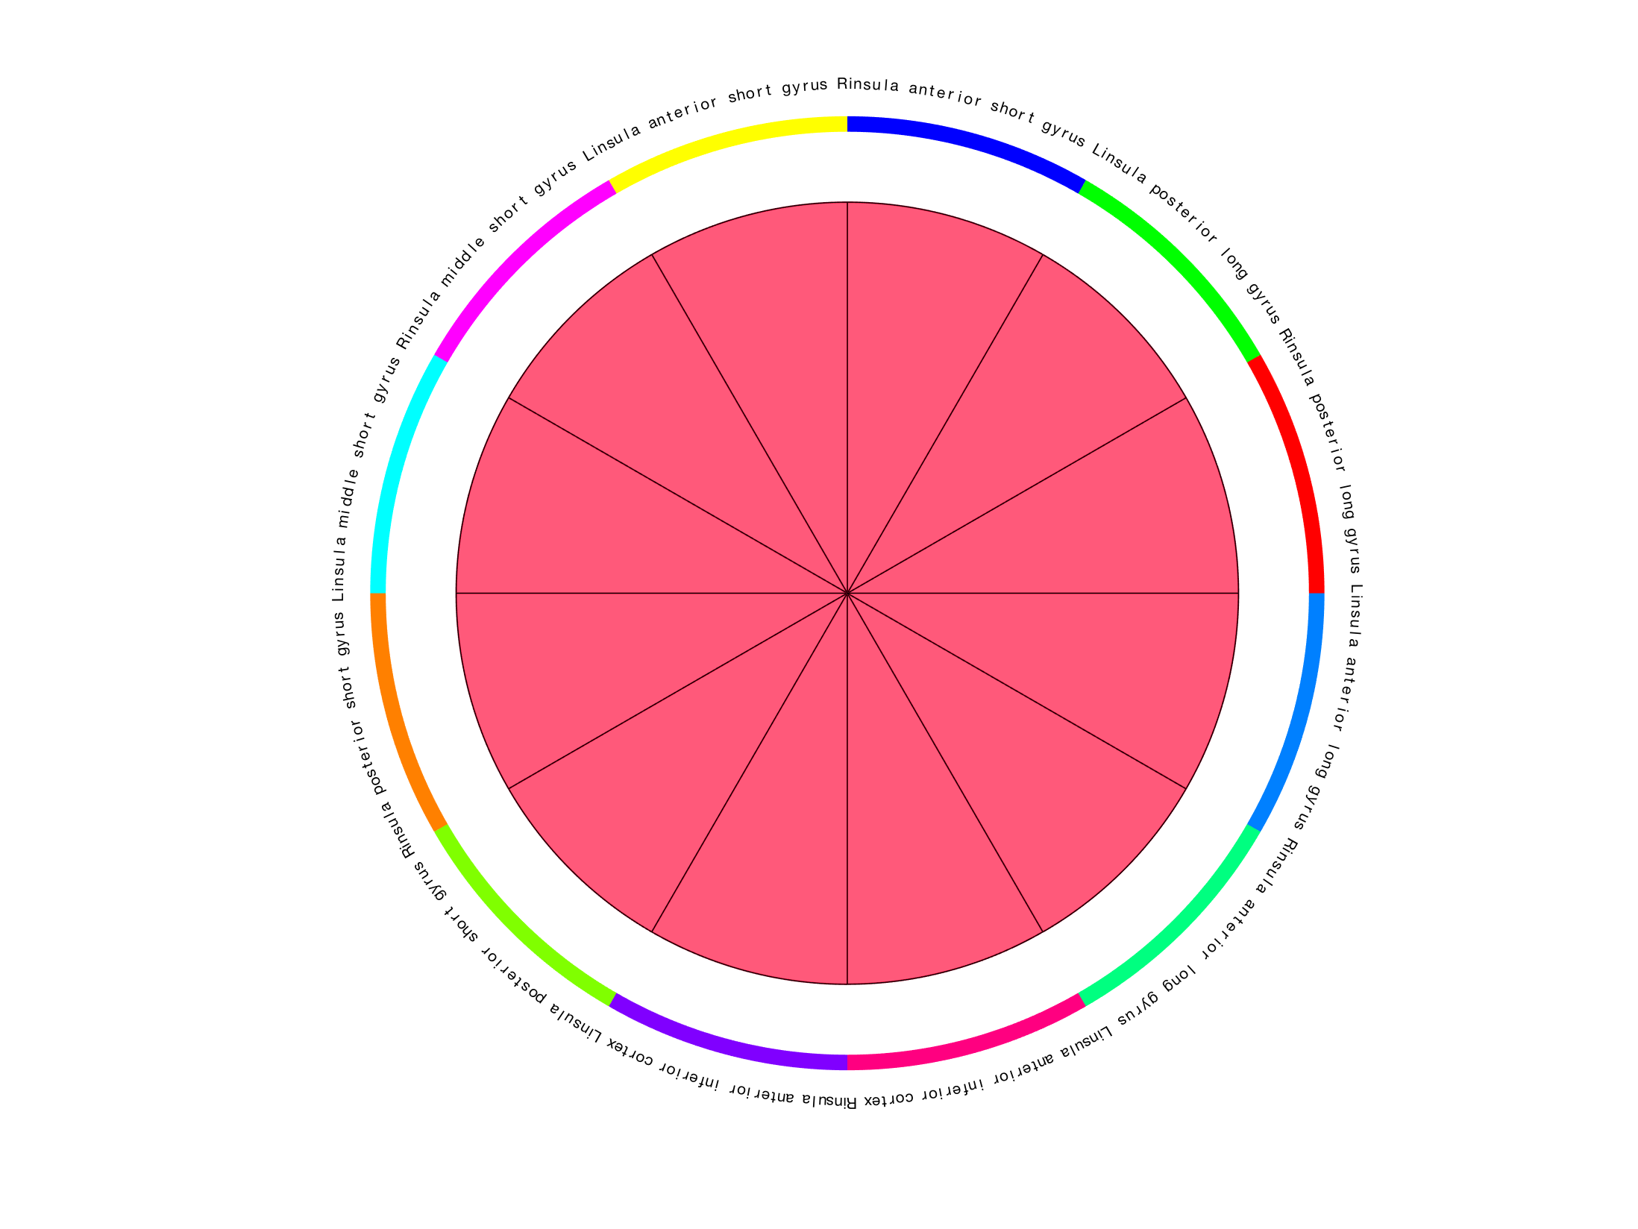
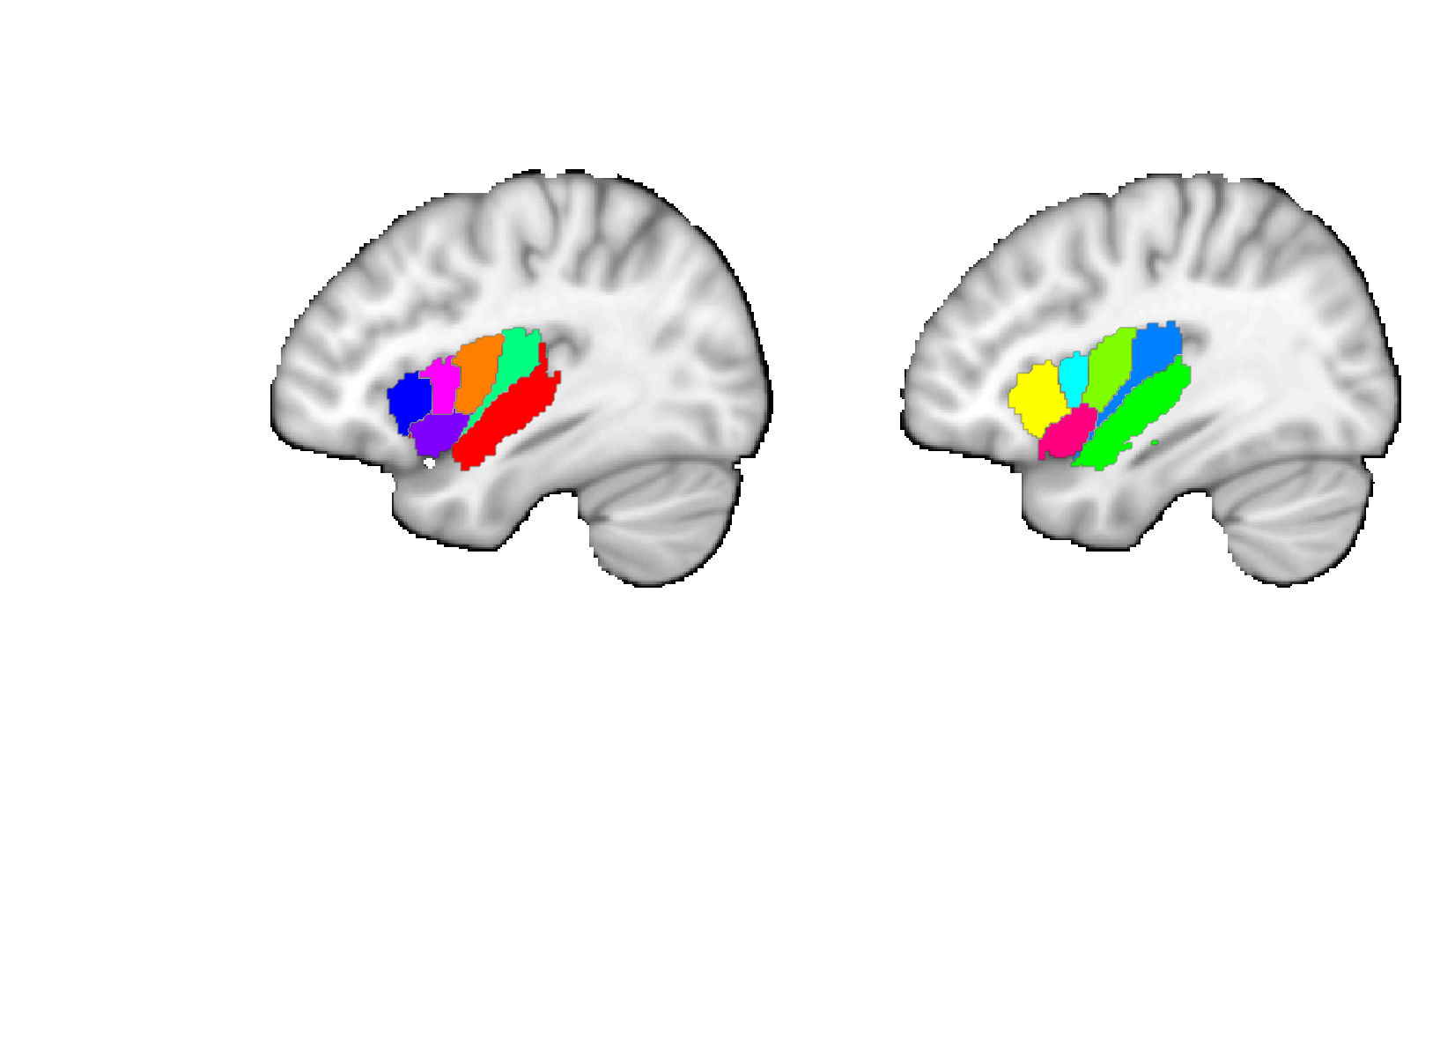
Faillenot insula
Post. short
Ant. long
Short
Long
Post.
Ant.
Middle short
Post. long
Mid.
Post.
Ant. short
Ant.
Ant. inf.
L
Ant. inferior
R
L
R

Slide 4
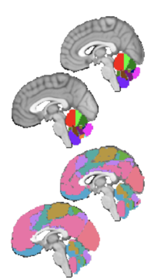
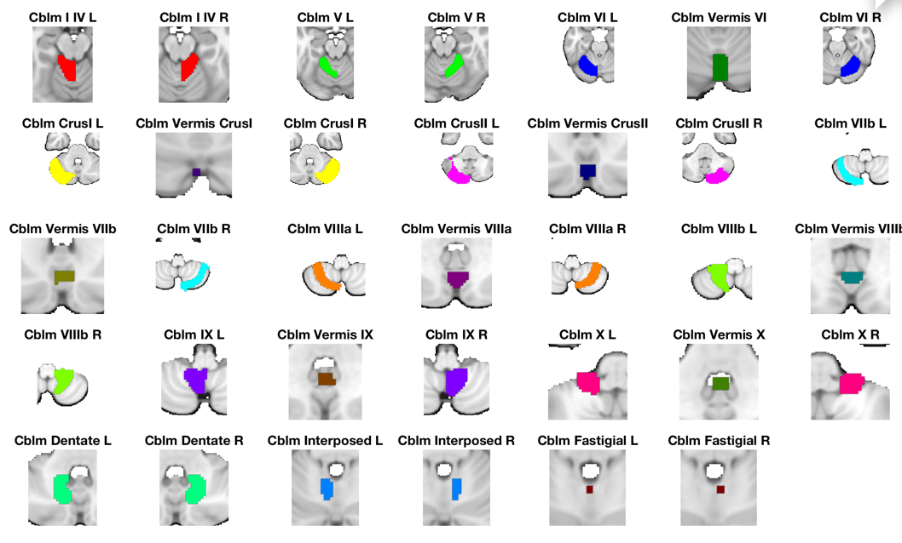
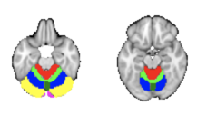
Diedrichsen Cerebellum
Diedrichsen, Jörn, Joshua H. Balsters, Jonathan Flavell, Emma Cussans, and Narender Ramnani. 2009. A Probabilistic MR Atlas of the Human Cerebellum. NeuroImage 46 (1): 39?46.’
Choi, Eun Young, B. T. Thomas Yeo, and Randy L. Buckner. 2012. “The Organization of the Human Striatum Estimated by Intrinsic Functional Connectivity.” Journal of Neurophysiology 108 (8): 2242–63.
Buckner, Randy L. 2013. “The Cerebellum and Cognitive Function: 25 Years of Insight from Anatomy and Neuroimaging.” Neuron 80 (3): 807–15.

Slide 5
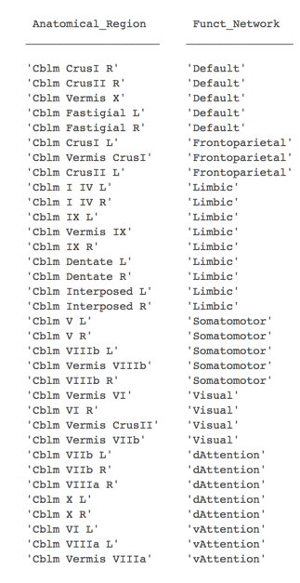
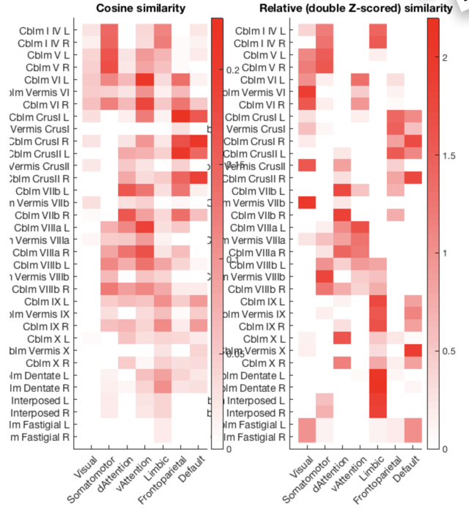
Cerebellum
Buckner/Yeo

Slide 6
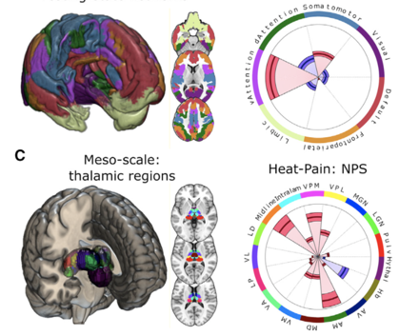
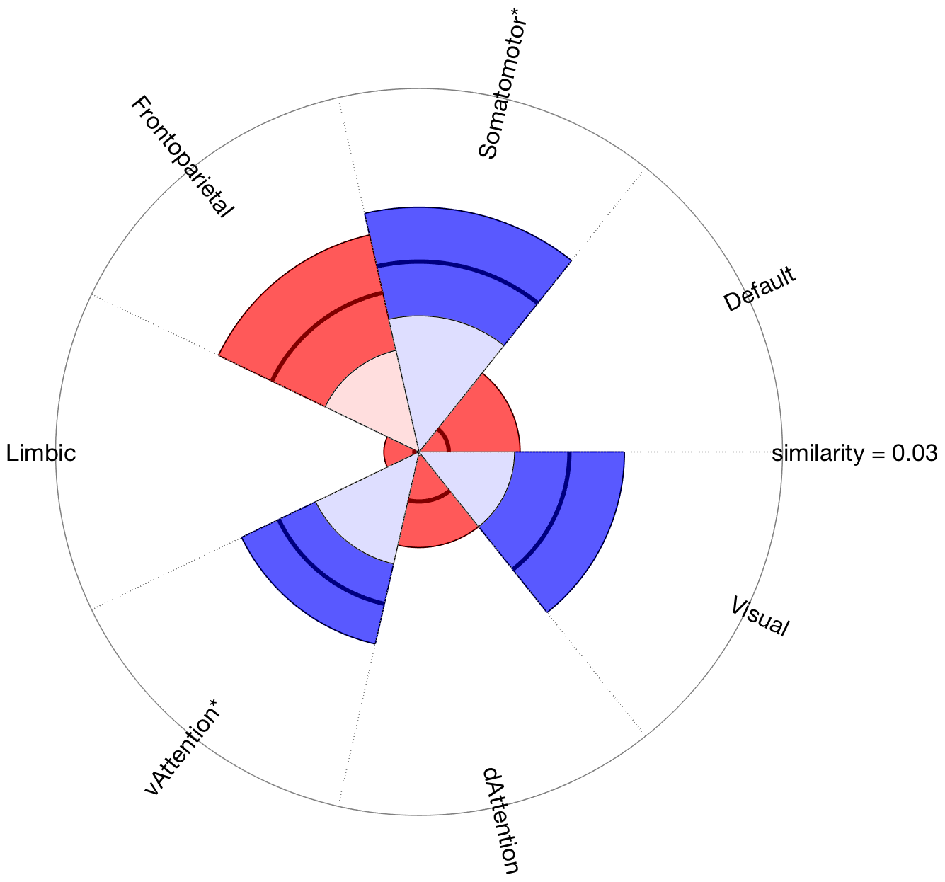
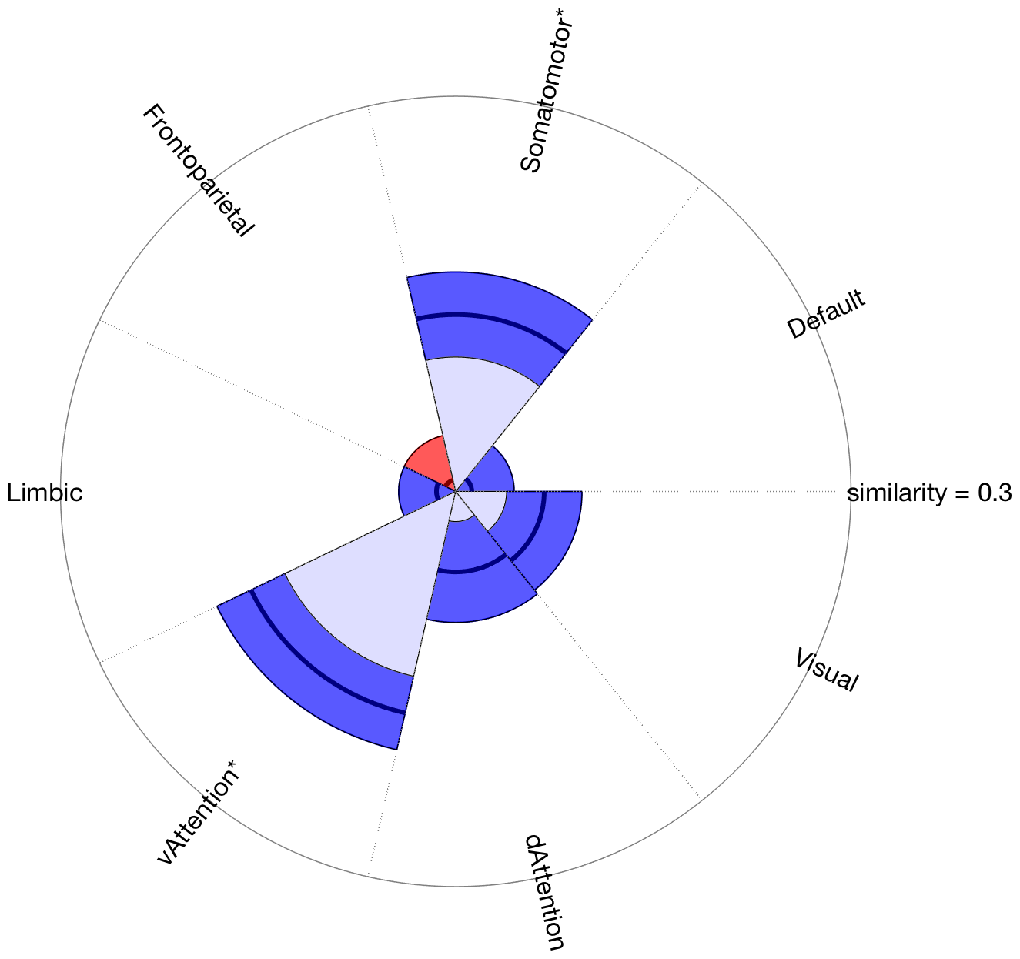
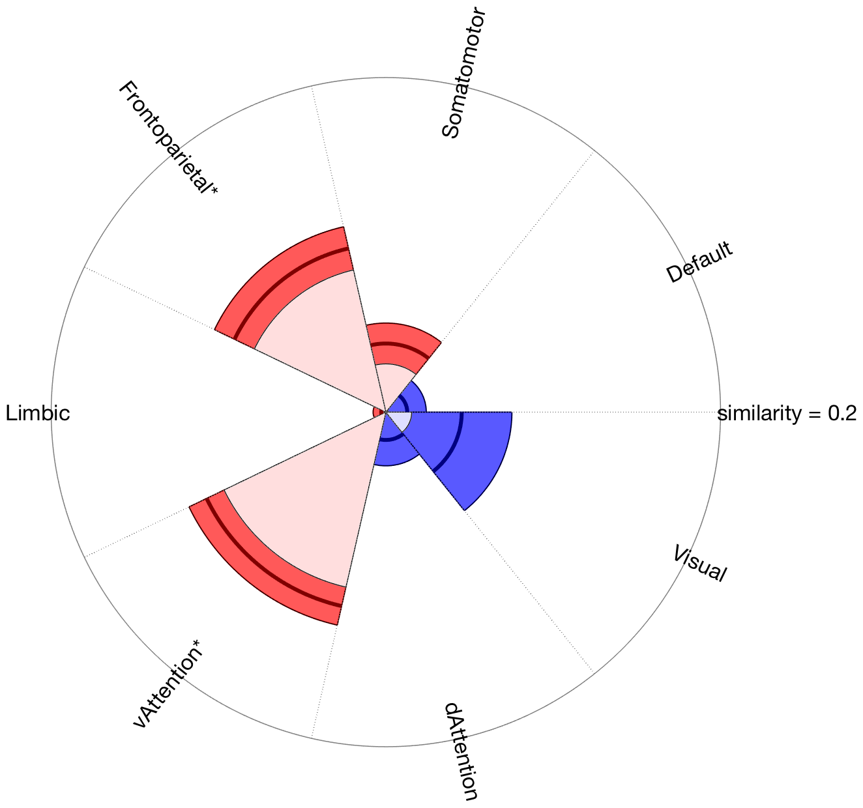
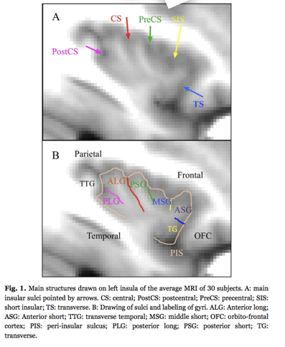
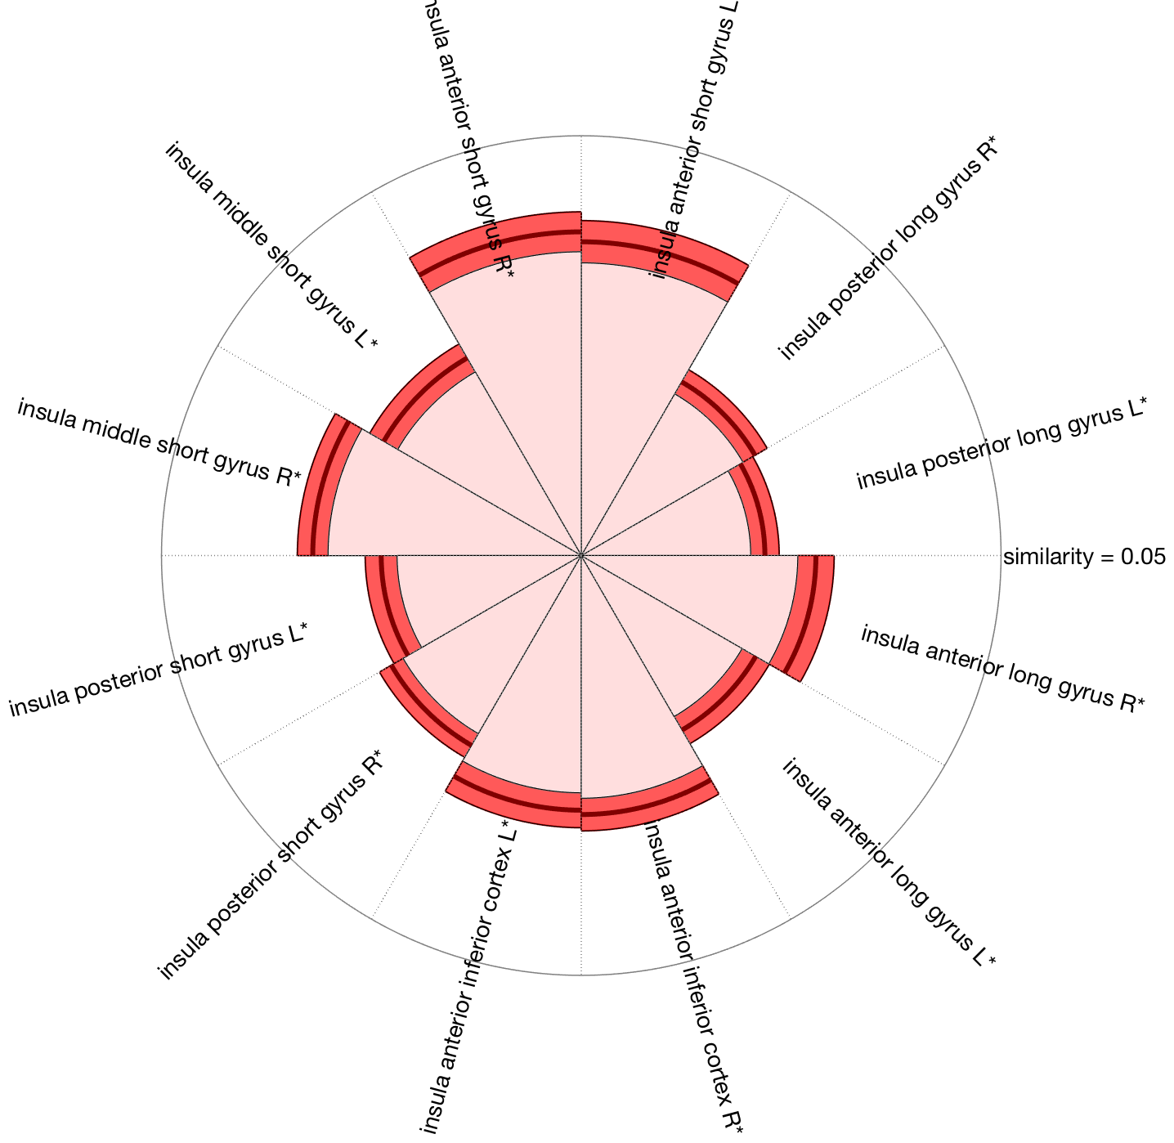
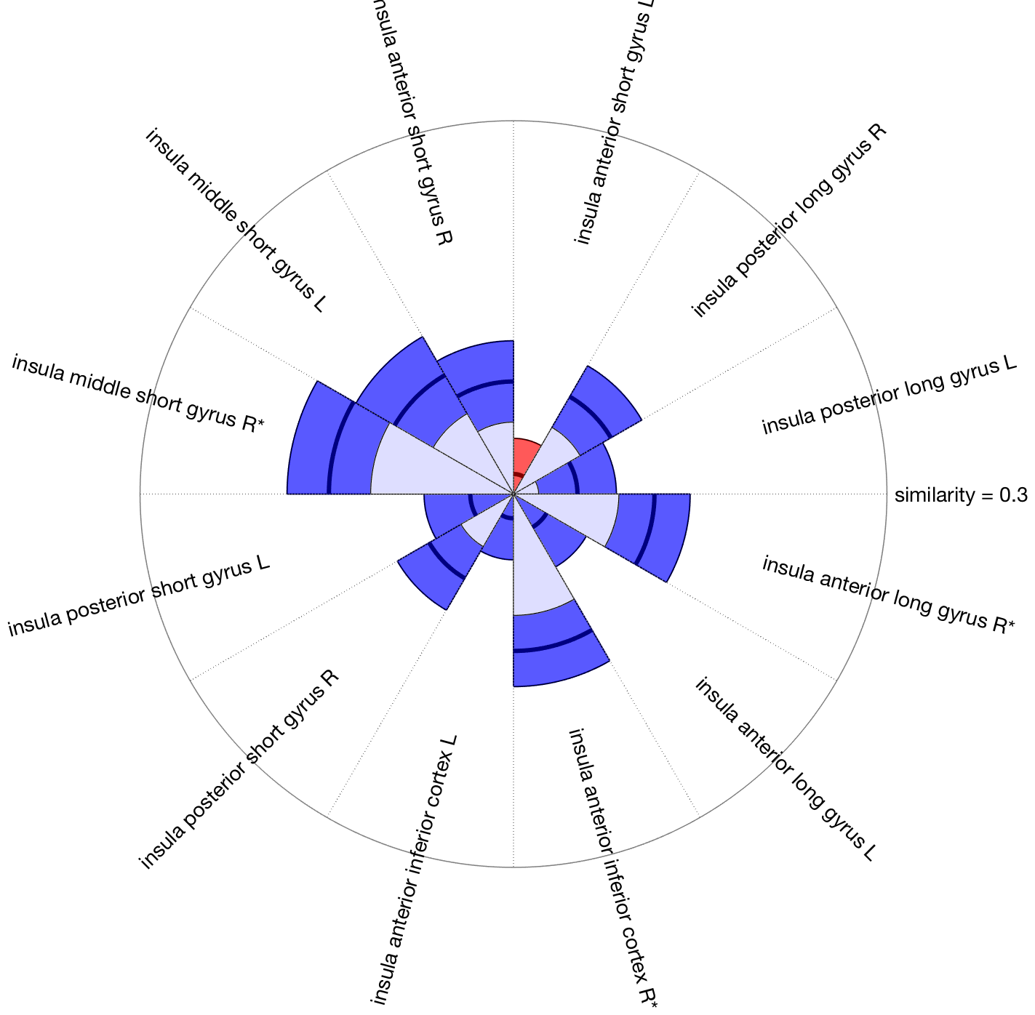
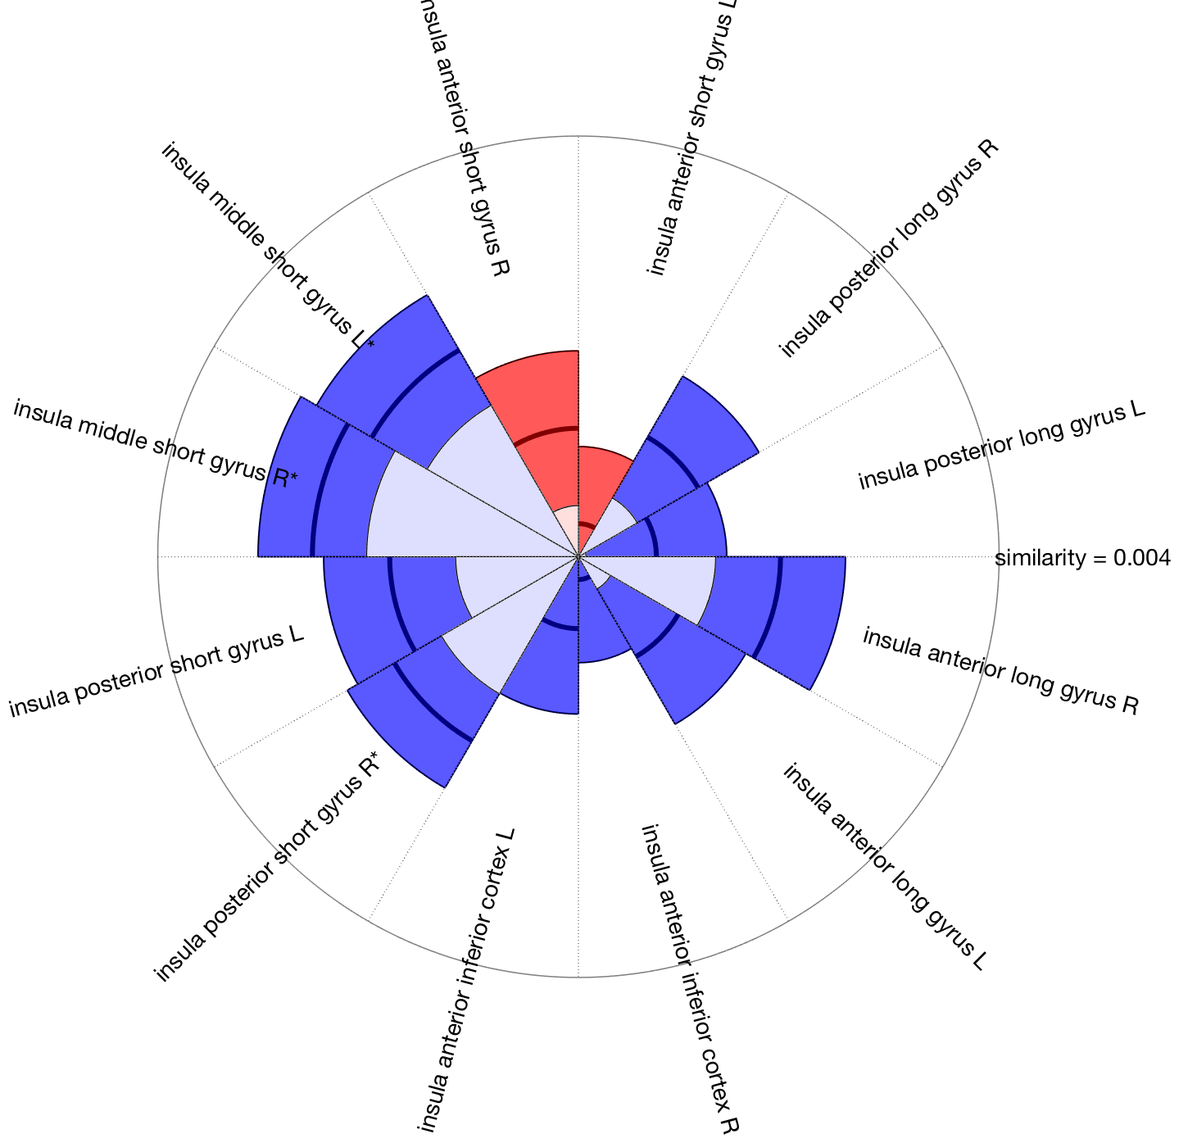
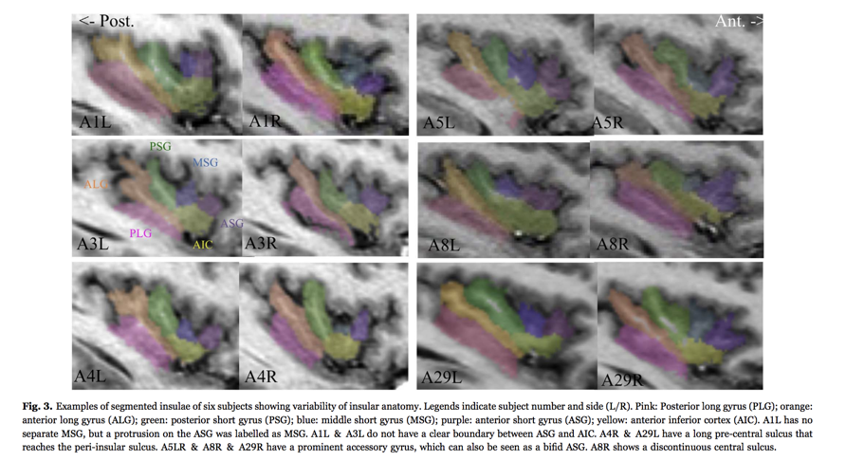
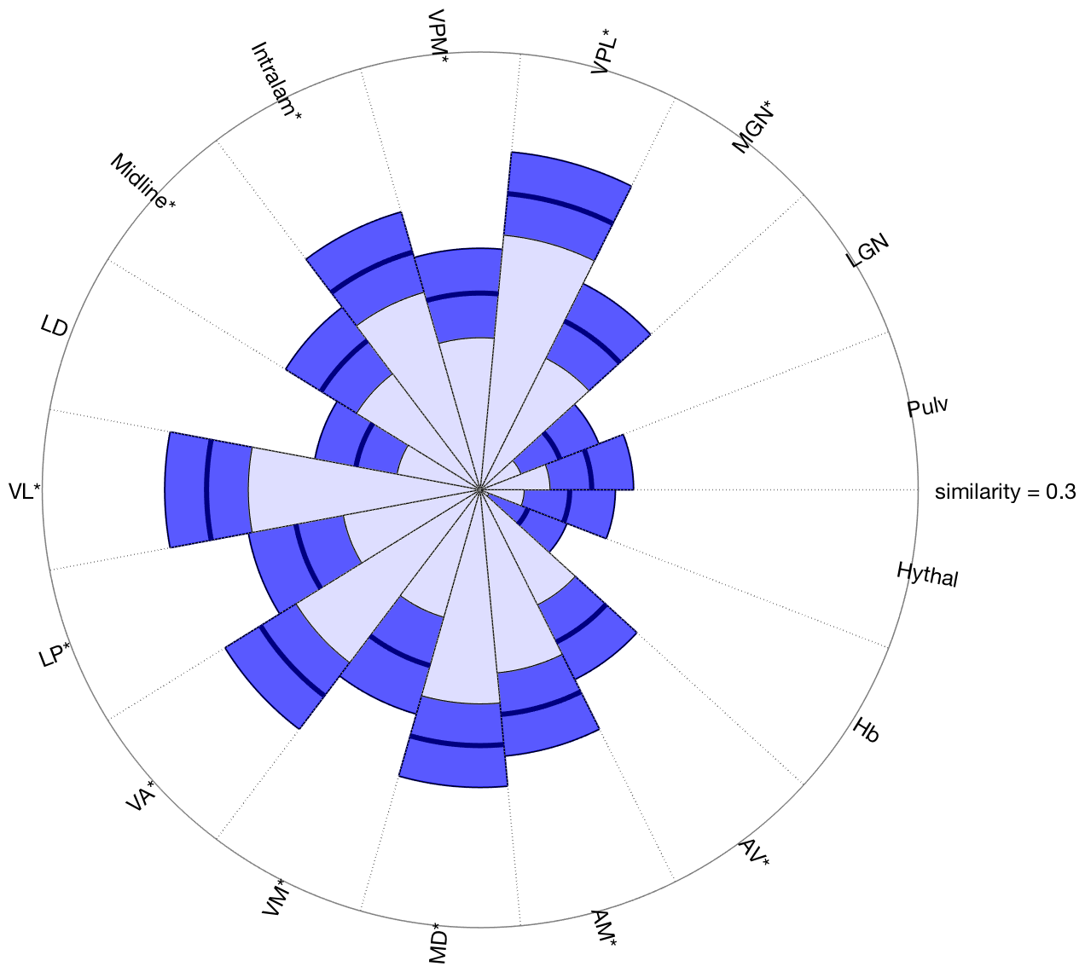
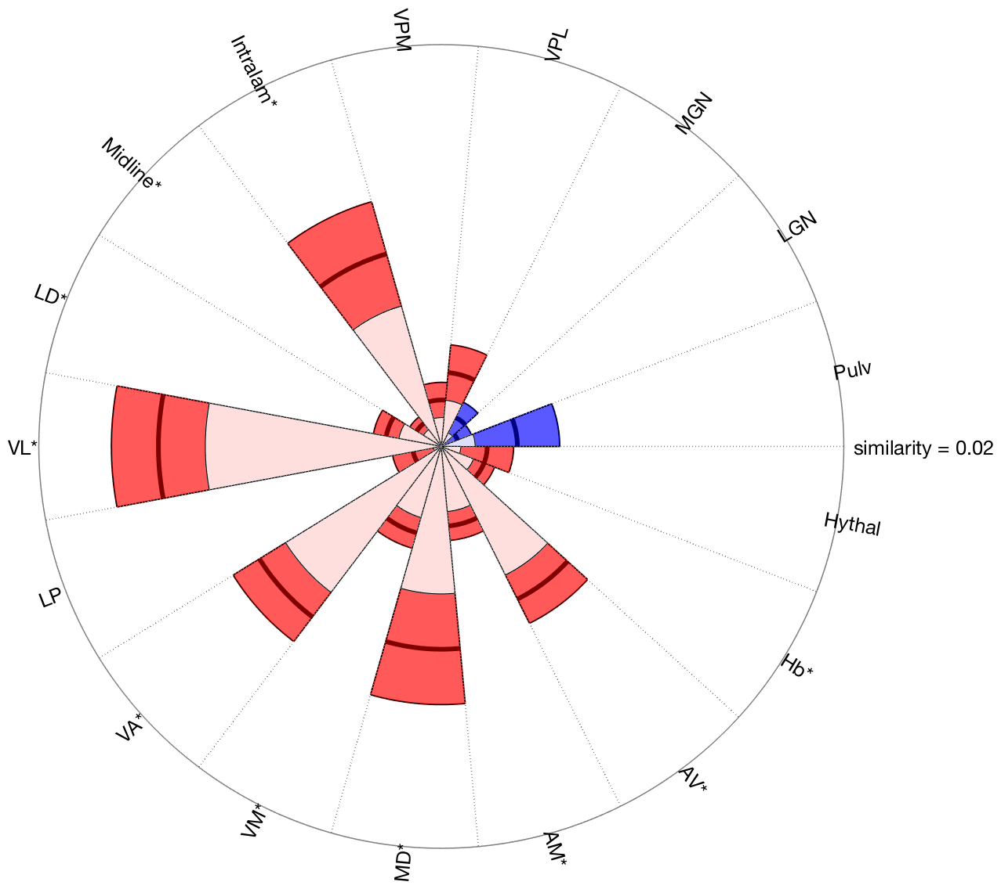
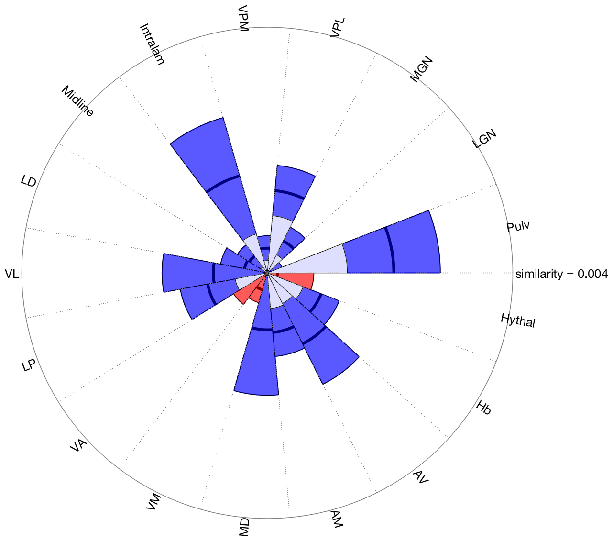
Pain
Placebo
Placebo correlations with analgesia
Somatomotor and ventral attn: strong increases with pain, reductions with placebo, correlated.
Frontoparietal : responds strongly to pain, some increase with placebo. But no correlations – so if there are frontal increases that correlate, don’t match these networks well.
Insula: MSG is dorsal anterior insula, activated by pain, reduced by placebo, and correlated. The ALG covers the posterior insula, which responds strongly to pain, and is reduced by placebo and correlated with placebo on the right side only. (Most studies are L side stim and activity in lateralized).
This supports changes in posterior insula in areas that support nociceptive processing. Ant. Inf. Cortex – ventral insula, correlated…
Strong increases with pain midline (intralam, MD) but others too. No strong decreases with placebo overall, but VPL pain pathway is close (one-tailed sig).
Correlations are strong both midline (IL, MD, and VPL → known pain pathways and pain responsive. Suggest that reductions in nociceptive/pain thalamus are strong in some individuals. NPS also shows some decreases that were correlated….
Other regions: VL, VA, AV: increases with pain and correlations with placebo…need further research on localization and function...

